Slide 1
Tutorial 4 Creating Forms and Reports

Slide 2
Objectives
Session 4.1
Create a form using the Form Wizard
Apply a theme to a form
Add a picture to a form
Change the color of text on a form
Find and maintain data using a form
Preview and print selected form records
Create a form with a main form and a subform

Slide 3
Objectives (Cont.)
Session 4.2
Create a report using the Report Wizard
Apply a theme to a report
Change the alignment of field values on a report
Move and resize fields in a report
Insert a picture in a report
Change the color of text on a report
Apply conditional formatting in a report
Preview and print a report

Slide 4
Creating Forms and Reports
Case - Chatham Community Health Services
Using Forms and Reports to Display Patient and Visit Data
User wants the database to include a form based on the Patient table to make it easier for staff members to enter and change data about the clinic’s patients
Also wants the database to include a form that shows data from both the Patient and Visit tables at the same time
Would like to include a formatted report of patient and visit data so they will have printed output when completing patient analyses and planning strategies for community outreach efforts

Slide 5
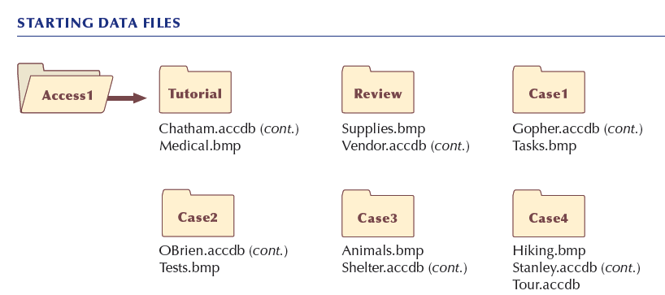
Creating Forms and Reports (Cont.)

Slide 6
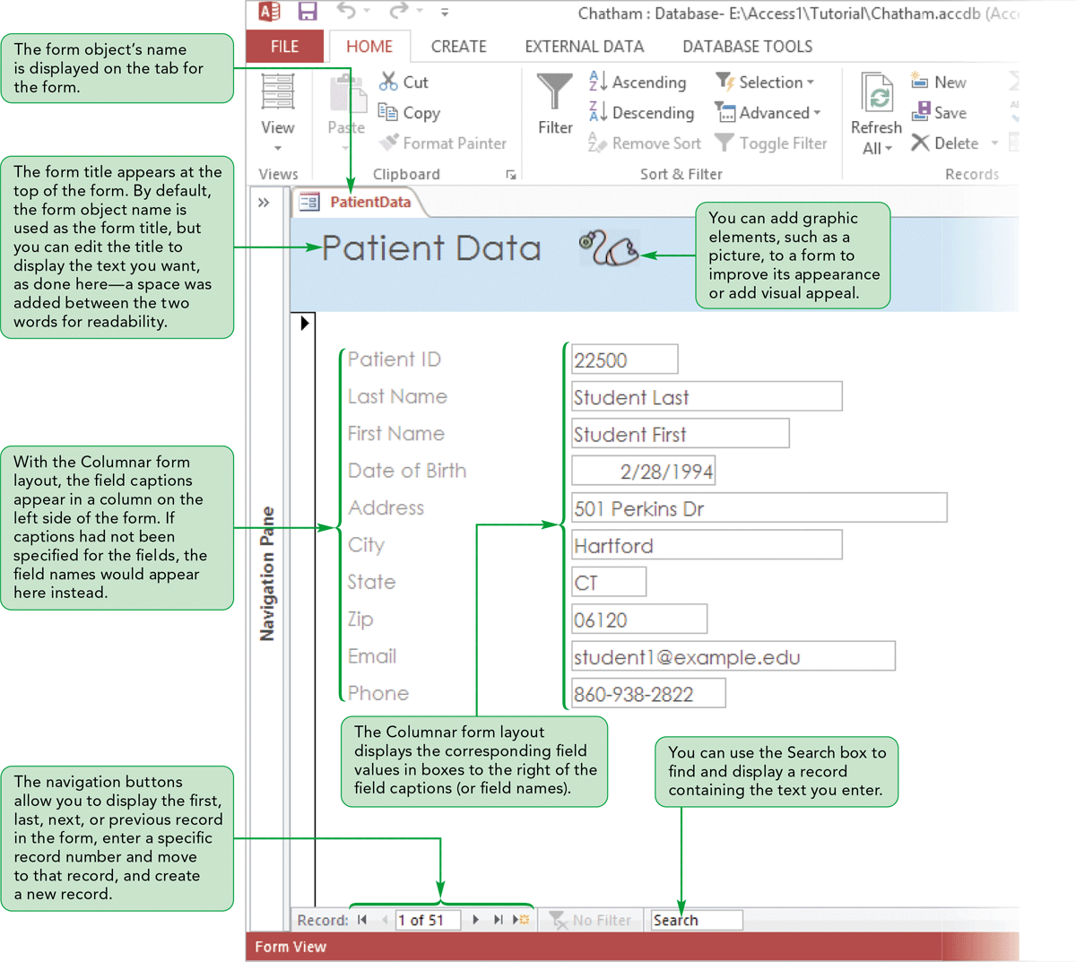
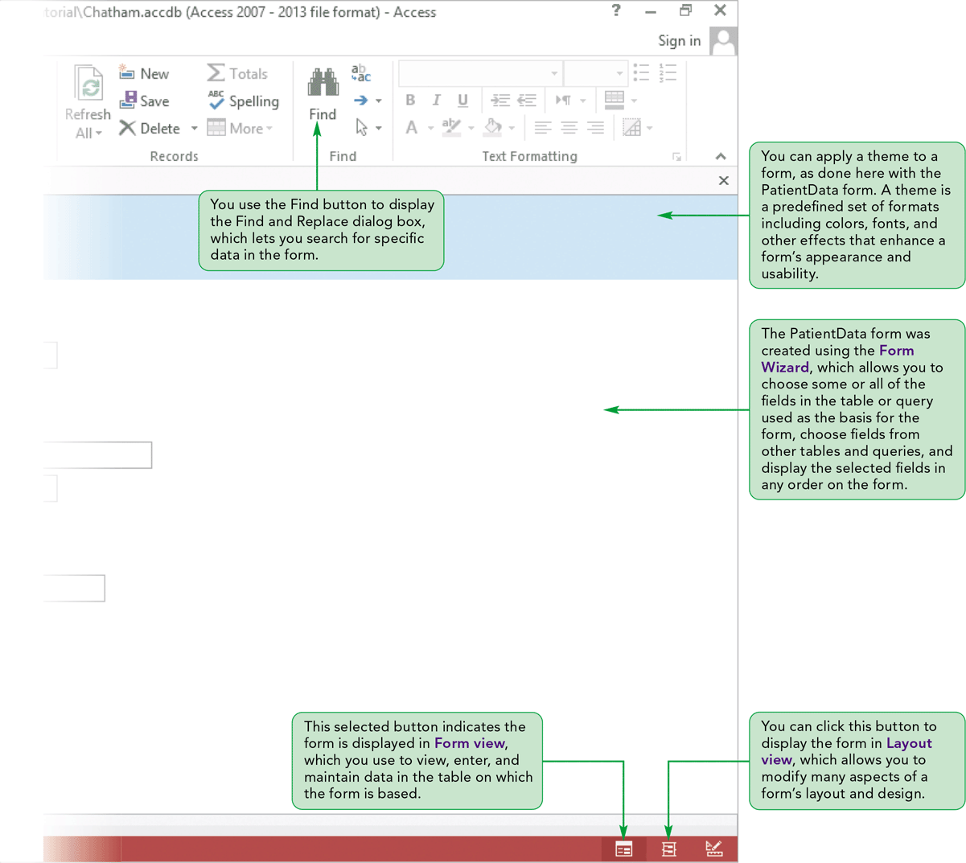
Creating Forms and Reports (Cont.)

Slide 7
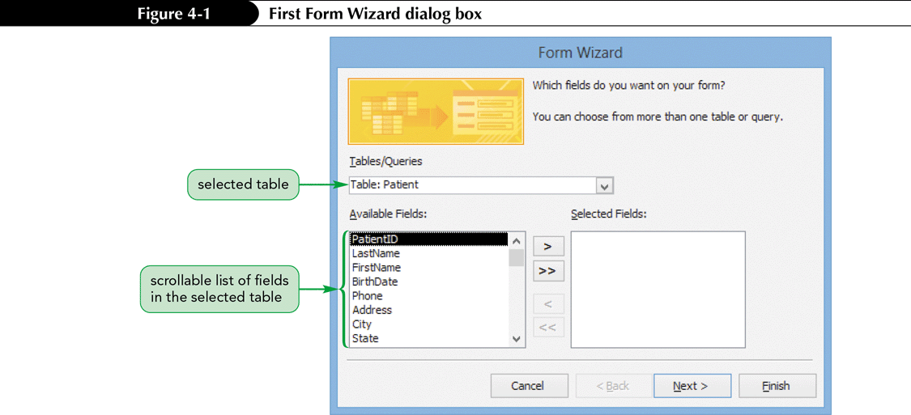
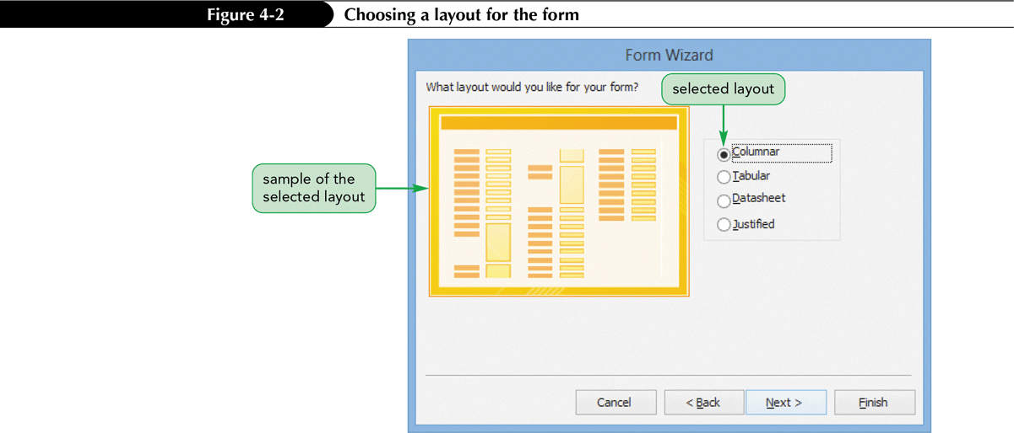
Creating a Form Using the Form Wizard
A form is an object you use to enter, edit, and view records in a database
You can design your own forms or have Access create them for you automatically

Slide 8
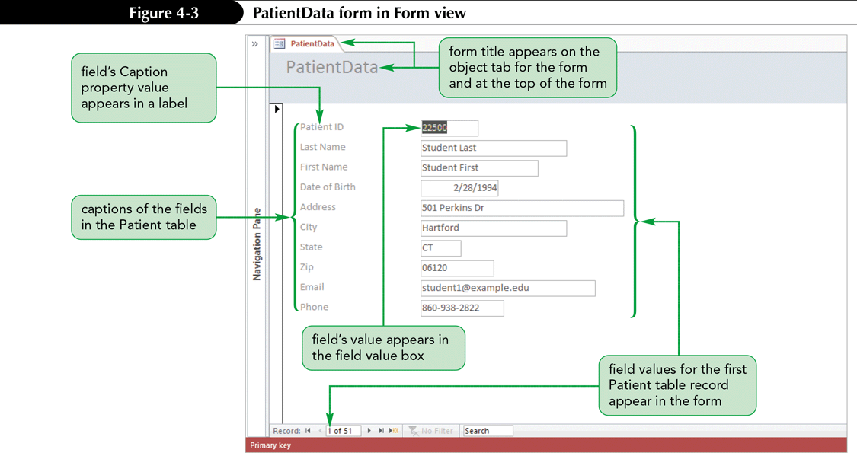
Creating a Form Using the Form Wizard (Cont.)

Slide 9
Modifying a Form’s Design in Layout View
You might need to modify its design in Layout view to improve its appearance or to make the form easier to use
In Layout view, you see the form as it appears in Form view, but you can still modify the form’s design
In Form view, you cannot make any design changes
Layout view makes it easy for you to see the results of any design changes you make
You can continue to make changes, undo modifications, and rework the design in Layout view to achieve the look you want for the form

Slide 10
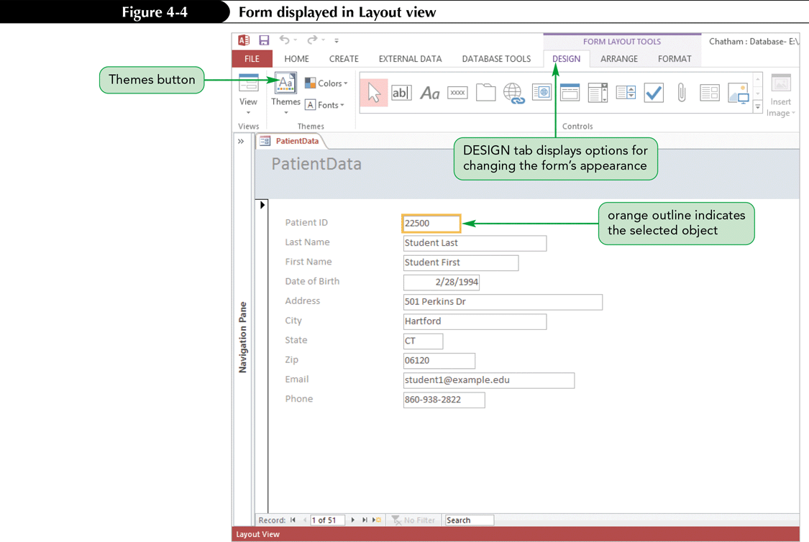
Modifying a Form’s Design in Layout View (Cont.)
Applying a Theme to a Form
By default, a forms use the Office theme, which determines the color and font used on the form
Access provides many built-in themes
Makes it easy to create objects with a unified look
You can also create a customized theme if none of the built-in themes suit your needs

Slide 11
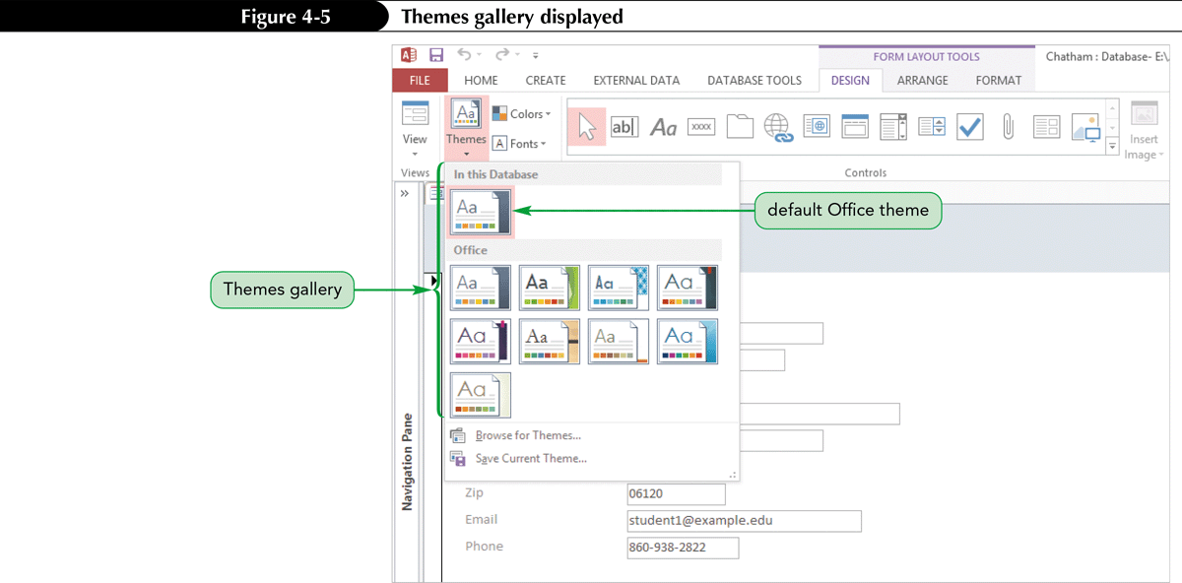
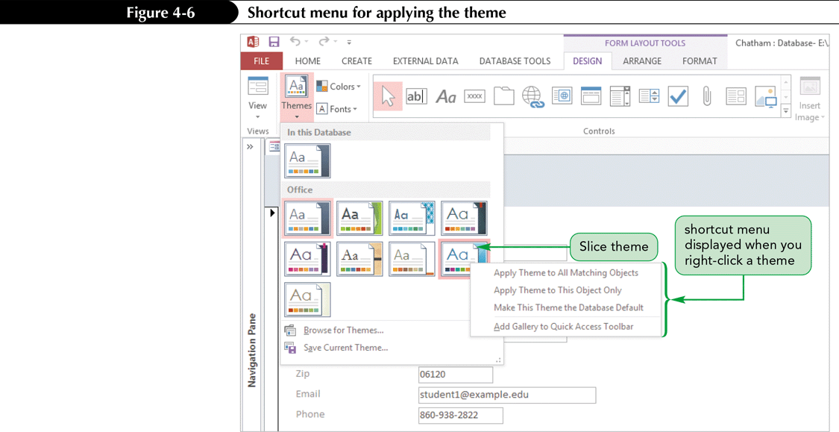
Modifying a Form’s Design in Layout View (Cont.)

Slide 12
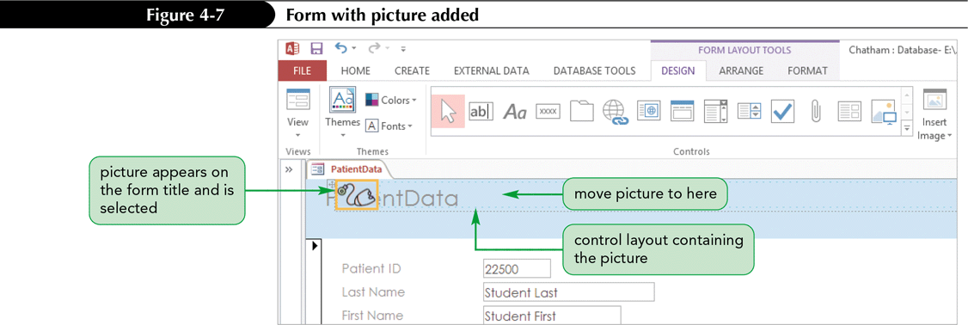
Modifying a Form’s Design in Layout View (Cont.)
Adding a Picture to a Form
A picture is one of many controls you can add and modify on a form
A control is an item on a form, report, or other database object that you can manipulate to modify the object’s appearance

Slide 13
Modifying a Form’s Design in Layout View (Cont.)
Changing the Color of the Form Title
The Font group on the FORMAT tab provides many options you can use to change the appearance of text on a form

Slide 14
Navigating a Form
To view, navigate, and change data using a form, you need to display the form in Form view
Navigate a form in the same way that you navigate a table datasheet
The navigation mode and editing mode keyboard shortcuts you used with datasheets in Tutorial 3 are the same when navigating a form

Slide 15
Finding Data Using a Form
The Find command lets you search for data in a datasheet so you can display only those records you want to view
You can also use the Find command to search for data in a form
You choose a field to serve as the basis for the search by making that field the current field, and then you enter the value you want Access to match in the Find and Replace dialog box

Slide 16
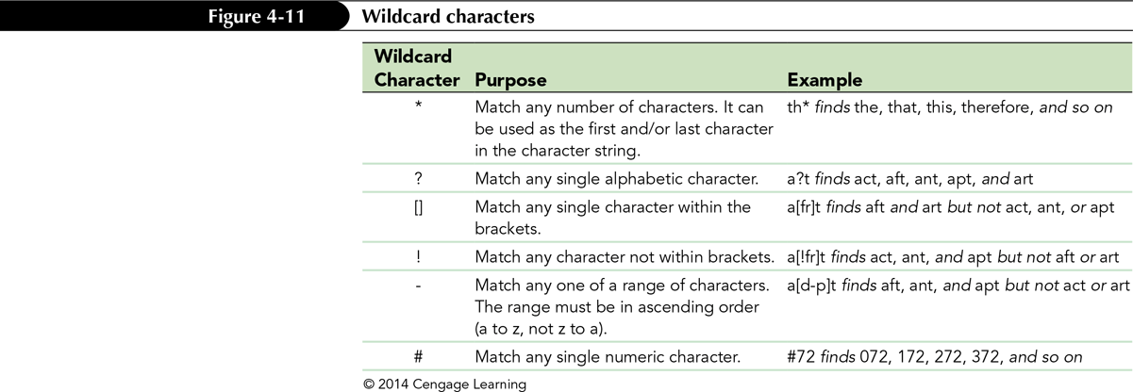
Finding Data Using a Form (Cont.)

Slide 17
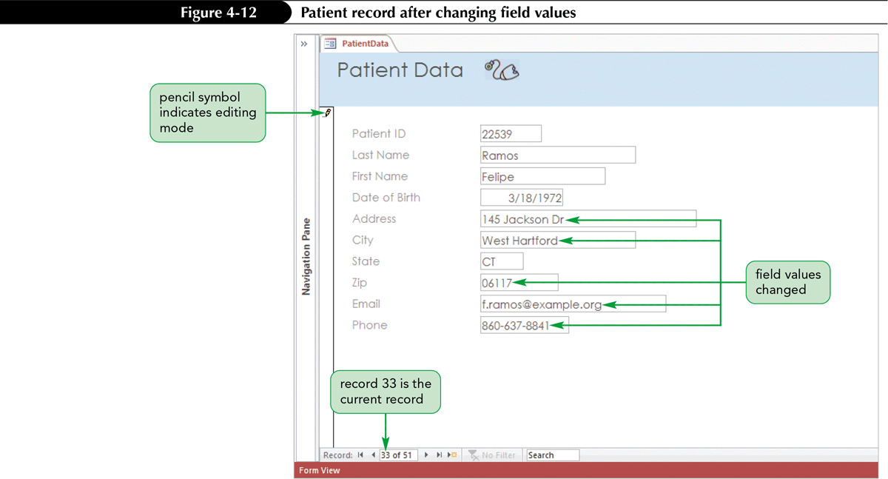
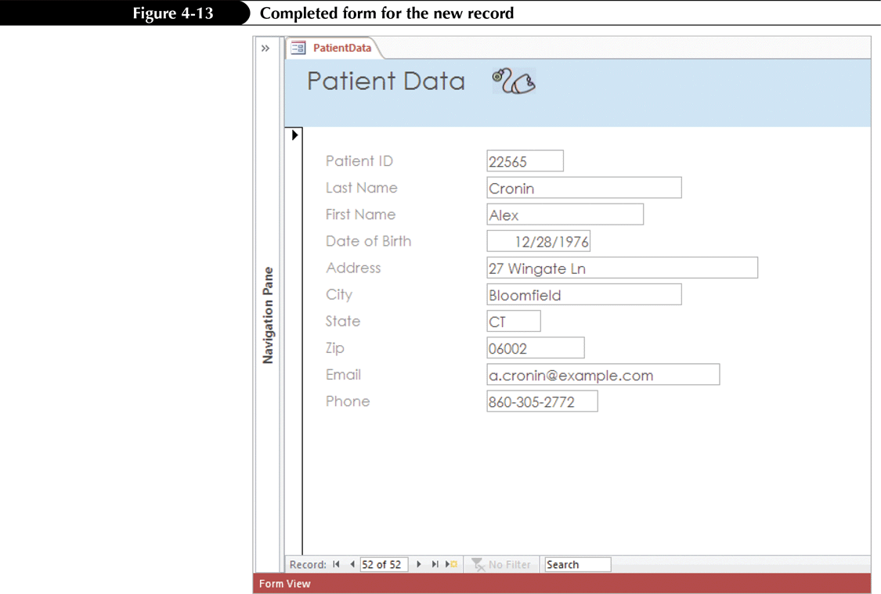
Maintaining Table Data Using a Form
Maintaining data using a form is often easier than using a datasheet because you can focus on all the changes for a single record at one time
In Form view, you can edit the field values for a record, delete a record from the underlying table, or add a new record

Slide 18
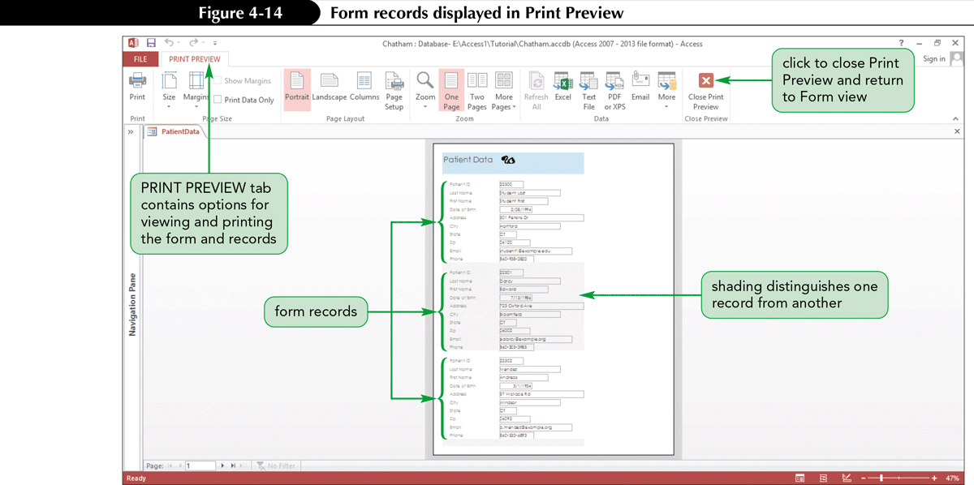
Previewing and Printing Selected Form Records
Access prints as many form records as can fit on a printed page
If only part of a form record fits on the bottom of a page, the remainder of the record prints on the next page
Access allows you to print all pages or a range of pages. In addition, you can print the currently selected form record

Slide 19
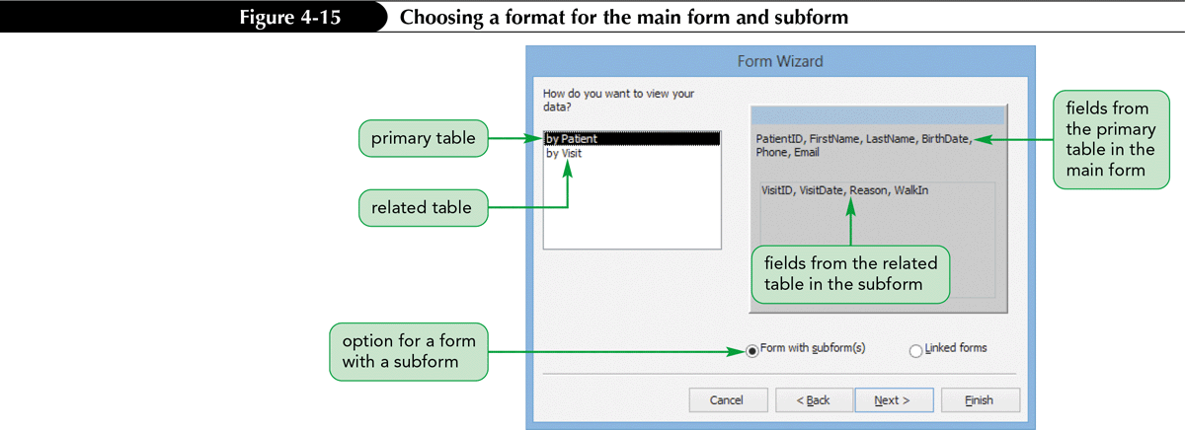
Creating a Form with a Main Form and a Subform
To create a form based on two tables, you must first define a relationship between the two tables
When you create a form containing data from two tables that have a one-to-many relationship, you actually create a main form for data from the primary table and a subform for data from the related table
Access uses the defined relationship between the tables to join them automatically through the common field that exists in both tables

Slide 20
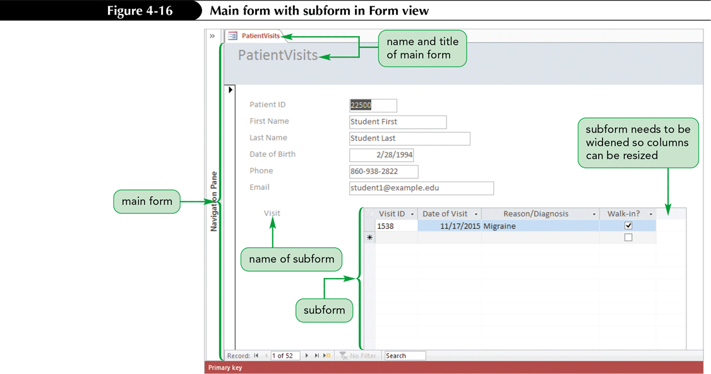
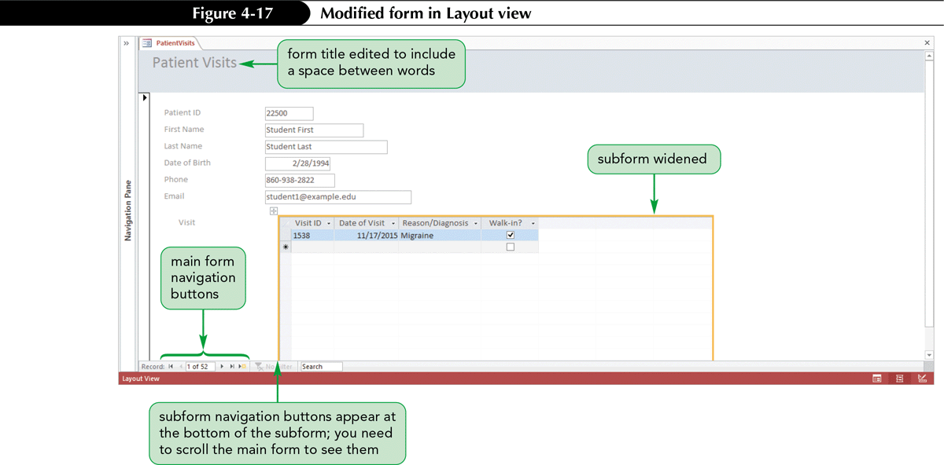
Creating a Form with a Main Form and a Subform (Cont.)

Slide 21
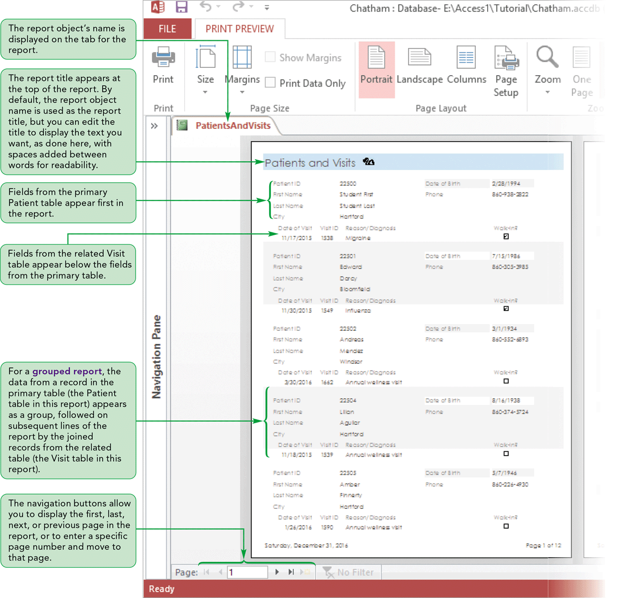
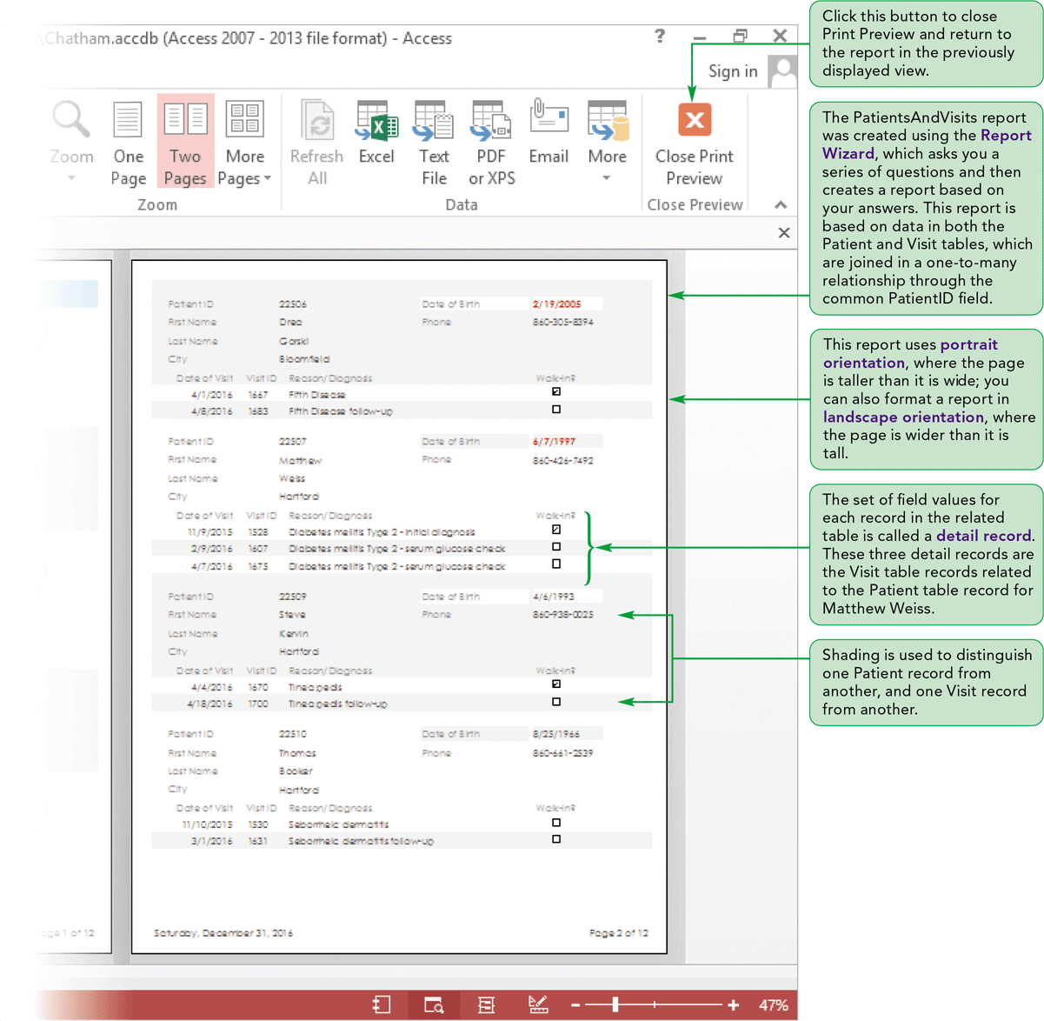
Creating a Report Using the Report Wizard

Slide 22
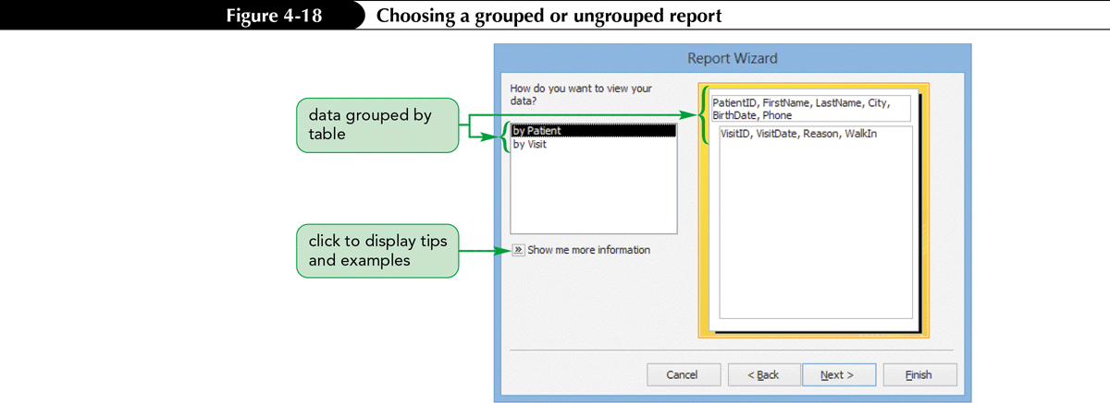
Creating a Report Using the Report Wizard (Cont.)
A report is a formatted printout or screen display of the contents of one or more tables or queries in a database
In Access, you can create your own reports or use the Report Wizard to create them for you
You can always change a report’s design after you create it

Slide 23
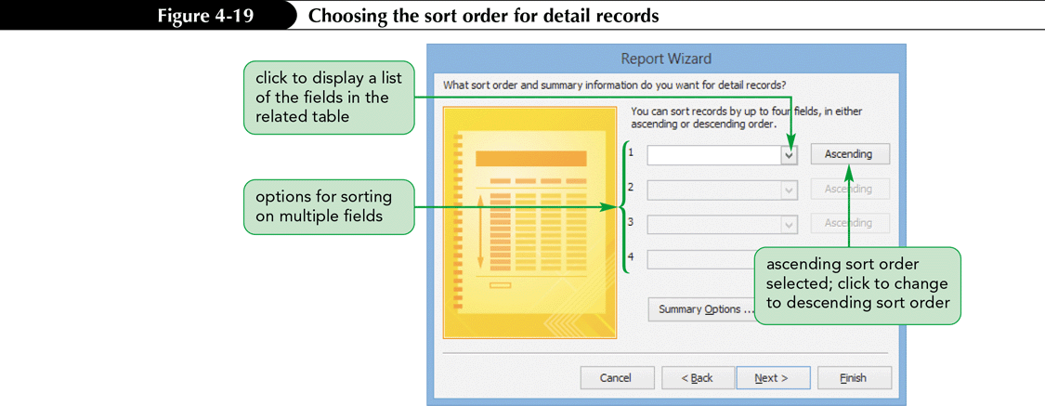
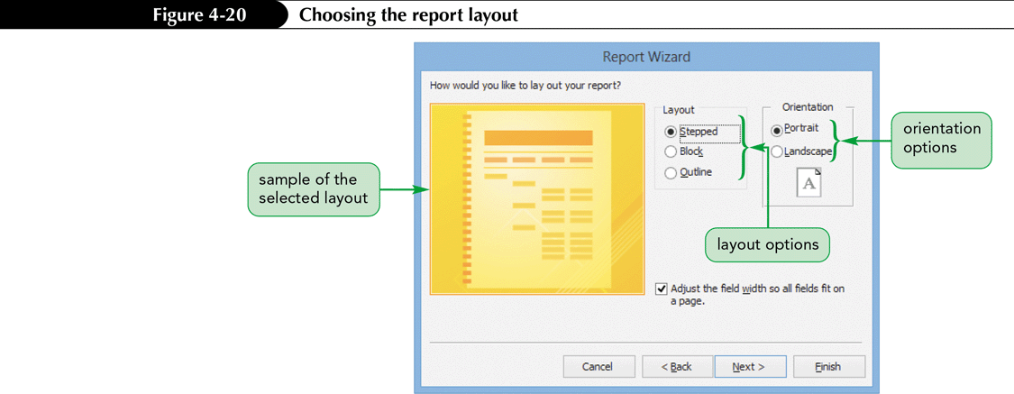
Creating a Report Using the Report Wizard (Cont.)

Slide 24
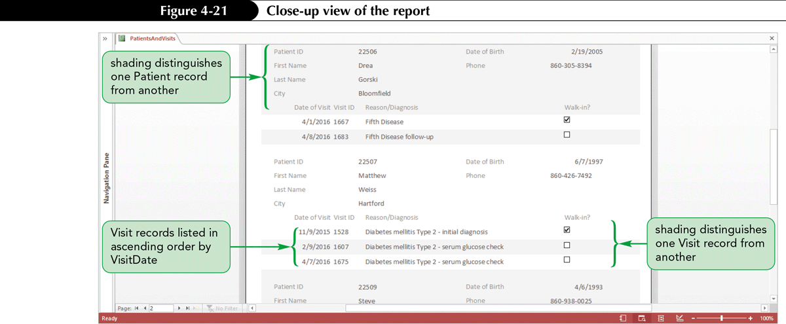
Creating a Report Using the Report Wizard (Cont.)

Slide 25
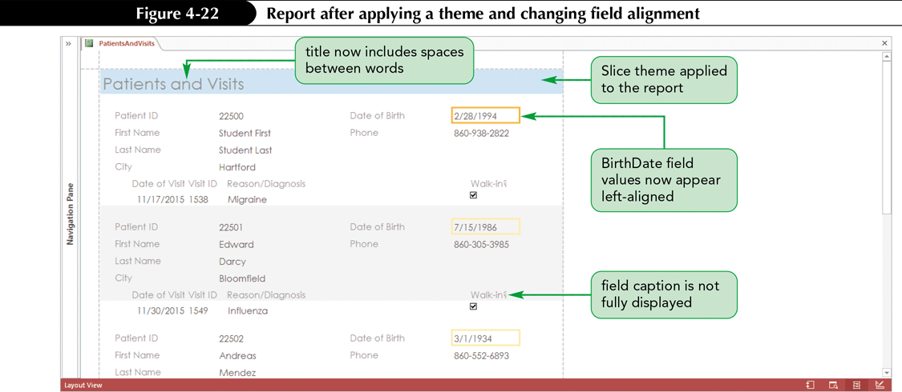
Modifying a Report’s Design in Layout View
Applying a Theme to a Report
The same themes available for forms are also available for reports
You can choose to apply a theme to the current report object only, or to all reports in the database
Changing the Alignment of Field Values
The FORMAT tab in Layout view, one of the REPORT LAYOUT TOOLS contextual tabs, provides options for you to easily modify the format of various report objects

Slide 26
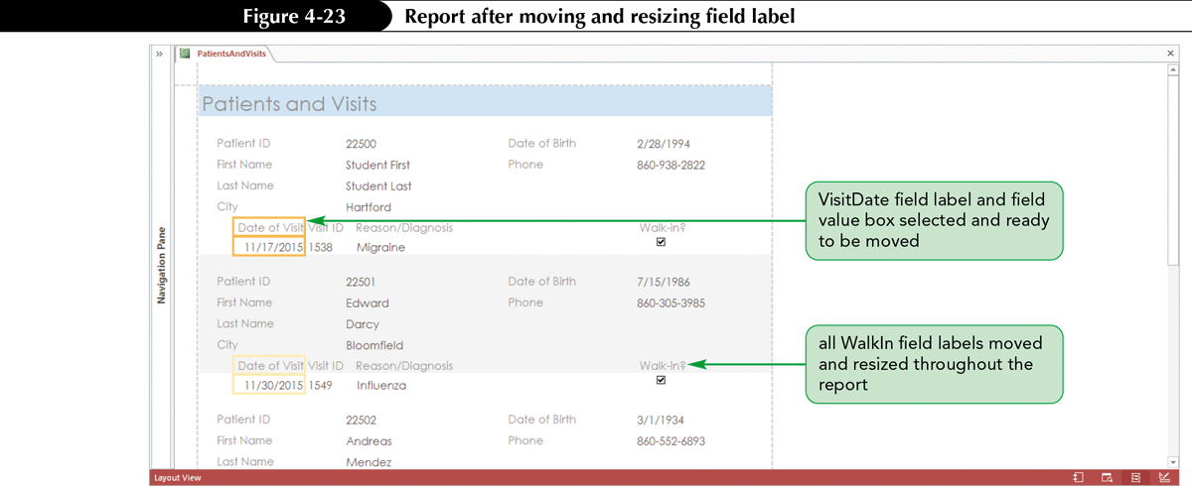
Modifying a Report’s Design in Layout View (Cont.)
Moving and Resizing Fields on a Report
Working in Layout view, you can resize and reposition fields and field value boxes to improve the appearance of a report or to address the problem of some field values not being completely displayed

Slide 27
Modifying a Report’s Design in Layout View (Cont.)
Changing the Title Font Color and Inserting a Picture in a Report
You can change the color of text on a report to enhance its appearance
You can also add a picture to a report for visual interest or to identify a particular section of the report

Slide 28
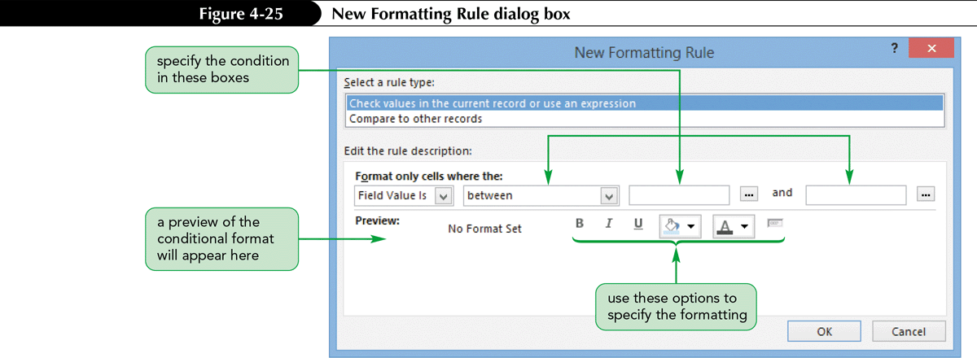
Using Conditional Formatting in a Report
Conditional formatting in a report (or form) is special formatting applied to certain field values depending on one or more conditions—similar to criteria you establish for queries
If a field value meets the condition or conditions you specify, the formatting is applied to the value

Slide 29
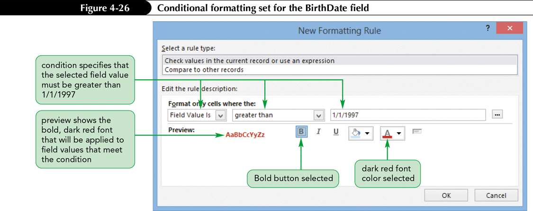
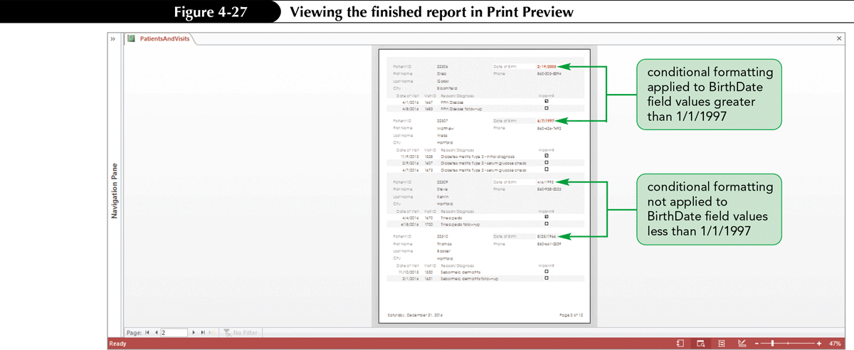
Using Conditional Formatting in a Report (Cont.)

Slide 30
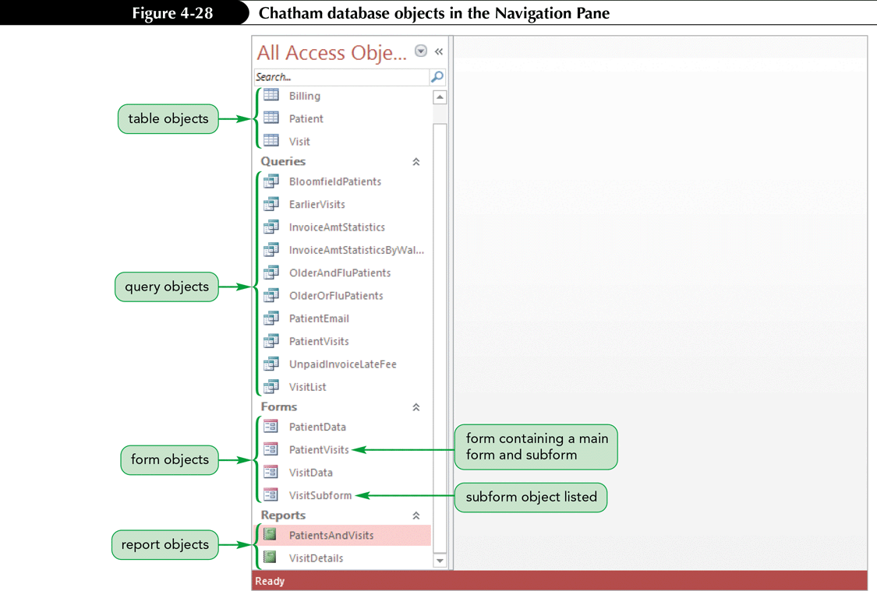
Using Conditional Formatting in a Report (Cont.)
Viewing the database objects in the Navigation Pane

